Slide 1
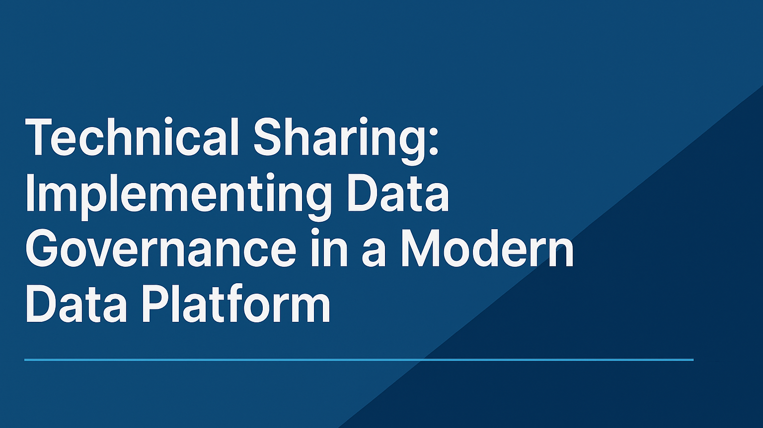
German Chung
9 January 2026

Slide 2
Agenda
01 | Why Governance Matters
02 | High-Level Data Governance in 3 Areas
03 | Data Domains — How Many and How to Define Them
04 | Roles & Responsibilities — What Actually Need to Know
05 | How Governance Is Implemented in the Data Platform

Slide 3
1. Why Governance Matters
Supplier Data Validation
Robust data validation and approval records in supplier help prevent procurement errors and enable corrective actions during compliance failures.
Ensuring Traceability and Trust
Governance builds traceability and accountability in materials, fostering trust among stakeholders and supporting reliable project outcomes.
Adaptability and Transparency
Governance adds resilience to construction projects, ensuring adaptability to regulations and transparent certification processes, reducing the risk of blame in failures.
Notes:
Image source: Microsoft 365 content library Effective governance ensures traceability, accountability, and trust in engineering. In supply chains, robust data validation and clear approval records prevent procurement errors and enable corrective actions when compliance fails. For enterprise projects, governance provides resilience and adaptability to regulatory changes, ensuring certifications and responsibilities are transparent and reducing blame in case of failures.

Slide 4
2. High-Level Data Governance in 3 Areas
Clear Data Ownership
Defining who owns and manages data ensures accountability and reliable data stewardship across the organization.
Transparency in Data Lineage
Understanding the flow and history of data boosts trust and enables better decision-making within the business.
Robust Access Control
Strong access controls protect sensitive information and ensure only authorized users can interact with organizational data.
All of this must be implemented in the PLATFORM, not in PowerPoint.
Notes:
Image source: Microsoft 365 content library Data governance is not just a committee, dashboard, or documentation exercise; it is about establishing clear ownership, definitions, and quality rules for organizational data. Effective governance includes transparency in data lineage, robust access control, and accountability for data management, ensuring consistent and trusted data usage across the business.

Slide 5
3. Data Domains — How Many and How to Define Them
A data domain is a business area with stable meaning and ownership.
For Construction scenarios, typical domains include:
Supplier
Material
Client
Engineer
Project Portfolio
Rule of thumb:
A domain exists when
It has factual data
It has a business owner
It has distinct quality rules
It has downstream dependencies
Notes:
Image source: Microsoft 365 content library Data governance is not just a committee, dashboard, or documentation exercise; it is about establishing clear ownership, definitions, and quality rules for organizational data. Effective governance includes transparency in data lineage, robust access control, and accountability for data management, ensuring consistent and trusted data usage across the business.

Slide 6
4. Roles & Responsibilities — What Actually Need to Know
Data Owner
Data Steward
Data Custodian
Data Engineer
Consulting Functions
Owns the truth of the domain.
Operates under the Data Owner.
Knows the source systems best.
The implementer.
Cybersecurity, Compliance, Internal Audit, etc
Notes:
Image source: Microsoft 365 content library Data governance is not just a committee, dashboard, or documentation exercise; it is about establishing clear ownership, definitions, and quality rules for organizational data. Effective governance includes transparency in data lineage, robust access control, and accountability for data management, ensuring consistent and trusted data usage across the business.

Slide 7
5. How Governance Is Implemented in the Data Platform
Implementing Data Glossary in the Platform
Implementing Data Quality Rules in Pipelines
Implementing Lineage Extraction
Implementing Authentication & Authorization
Implementing Accountability Trails
Notes:
Image source: Microsoft 365 content library Data governance is not just a committee, dashboard, or documentation exercise; it is about establishing clear ownership, definitions, and quality rules for organizational data. Effective governance includes transparency in data lineage, robust access control, and accountability for data management, ensuring consistent and trusted data usage across the business.

Slide 8
5. I. Implementing Data Glossary in the Platform
Glossary terms must map to:
Schema fields
Business definitions
Quality rules
Lineage
Owners & stewards
Implementation:
Store glossary in metadata repo
Expose via catalog (Purview, Collibra, DataHub, Amundsen)
Link glossary → schema → pipeline → dashboard
Notes:
Image source: Microsoft 365 content library Data governance is not just a committee, dashboard, or documentation exercise; it is about establishing clear ownership, definitions, and quality rules for organizational data. Effective governance includes transparency in data lineage, robust access control, and accountability for data management, ensuring consistent and trusted data usage across the business.

Slide 9
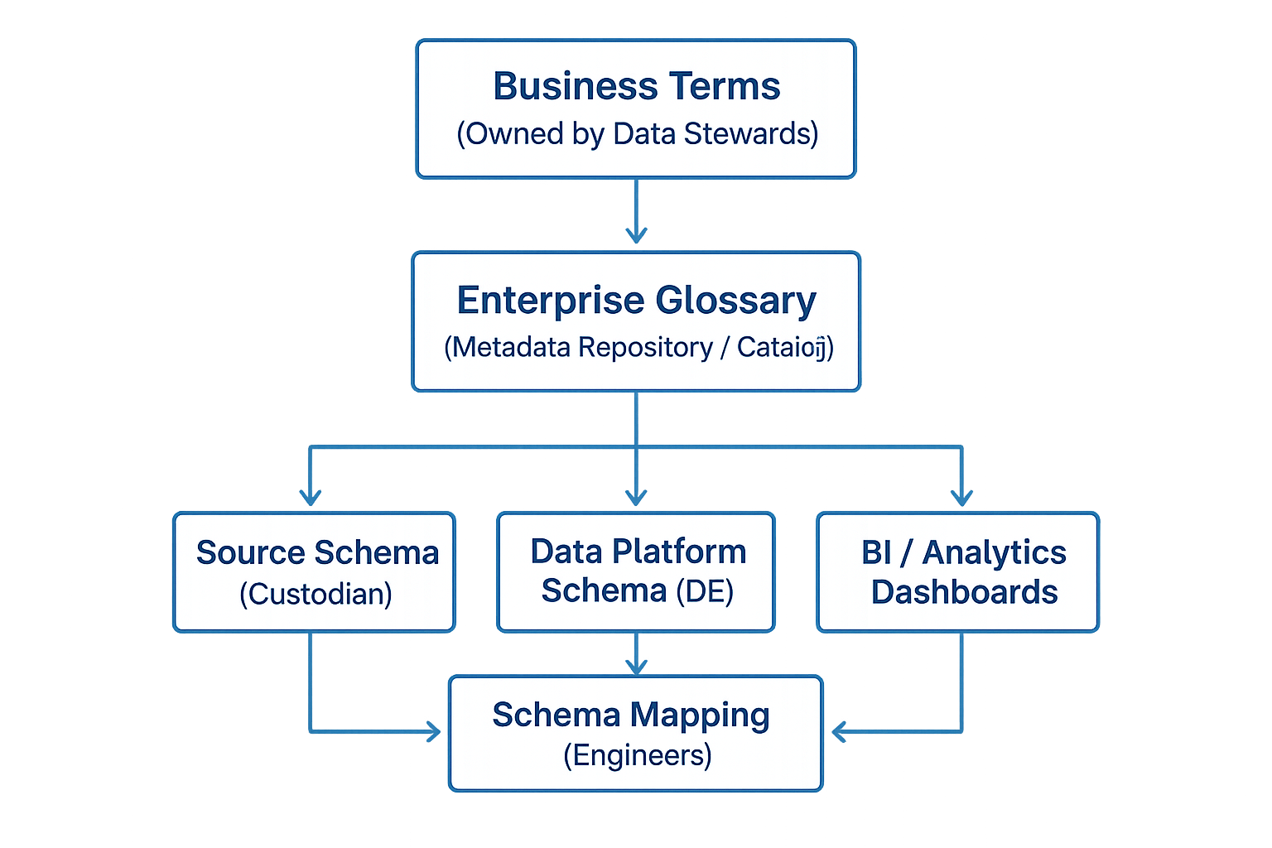
5. I. Data Glossary Architecture
Notes:
Image source: Microsoft 365 content library Data governance is not just a committee, dashboard, or documentation exercise; it is about establishing clear ownership, definitions, and quality rules for organizational data. Effective governance includes transparency in data lineage, robust access control, and accountability for data management, ensuring consistent and trusted data usage across the business.

Slide 10
5. I. Sample Metadata Schema (YAML)
term_id: SUPPLIER_COUNTRY
name: Supplier Country
domain: Supplier
business_definition: "The registered country of the supplier as provided during onboarding."
not_in_scope:
- "Country of manufacturing"
- "Country of shipment"
data_steward: "steward.supplier@company.com"
data_owner: "owner.supplier@company.com"
technical_mapping:
table: supplier_raw
column: country_code
quality_rules:
- RULE_COUNTRY_ISO
lineage_tags:
- source: supplier_portal
transformation: "Direct mapping"
target: supplier_clean.country
Notes:
Image source: Microsoft 365 content library Data governance is not just a committee, dashboard, or documentation exercise; it is about establishing clear ownership, definitions, and quality rules for organizational data. Effective governance includes transparency in data lineage, robust access control, and accountability for data management, ensuring consistent and trusted data usage across the business.

Slide 11
5. I. Sample Metadata Schema (JSON)
{
"term_id": "SUPPLIER_COUNTRY",
"name": "Supplier Country",
"domain": "Supplier",
"business_definition": "The registered country of the supplier as provided during onboarding.",
"not_in_scope": [
"Country of manufacturing",
"Country of shipment"
],
"data_steward": "steward.supplier@company.com",
"data_owner": "owner.supplier@company.com",
"technical_mapping": {
"table": "supplier_raw",
"column": "country_code"
},
"quality_rules": ["RULE_COUNTRY_ISO"],
"lineage_tags": [
{
"source": "supplier_portal",
"transformation": "Direct mapping",
"target": "supplier_clean.country"
}
]
}
Notes:
Image source: Microsoft 365 content library Data governance is not just a committee, dashboard, or documentation exercise; it is about establishing clear ownership, definitions, and quality rules for organizational data. Effective governance includes transparency in data lineage, robust access control, and accountability for data management, ensuring consistent and trusted data usage across the business.

Slide 12
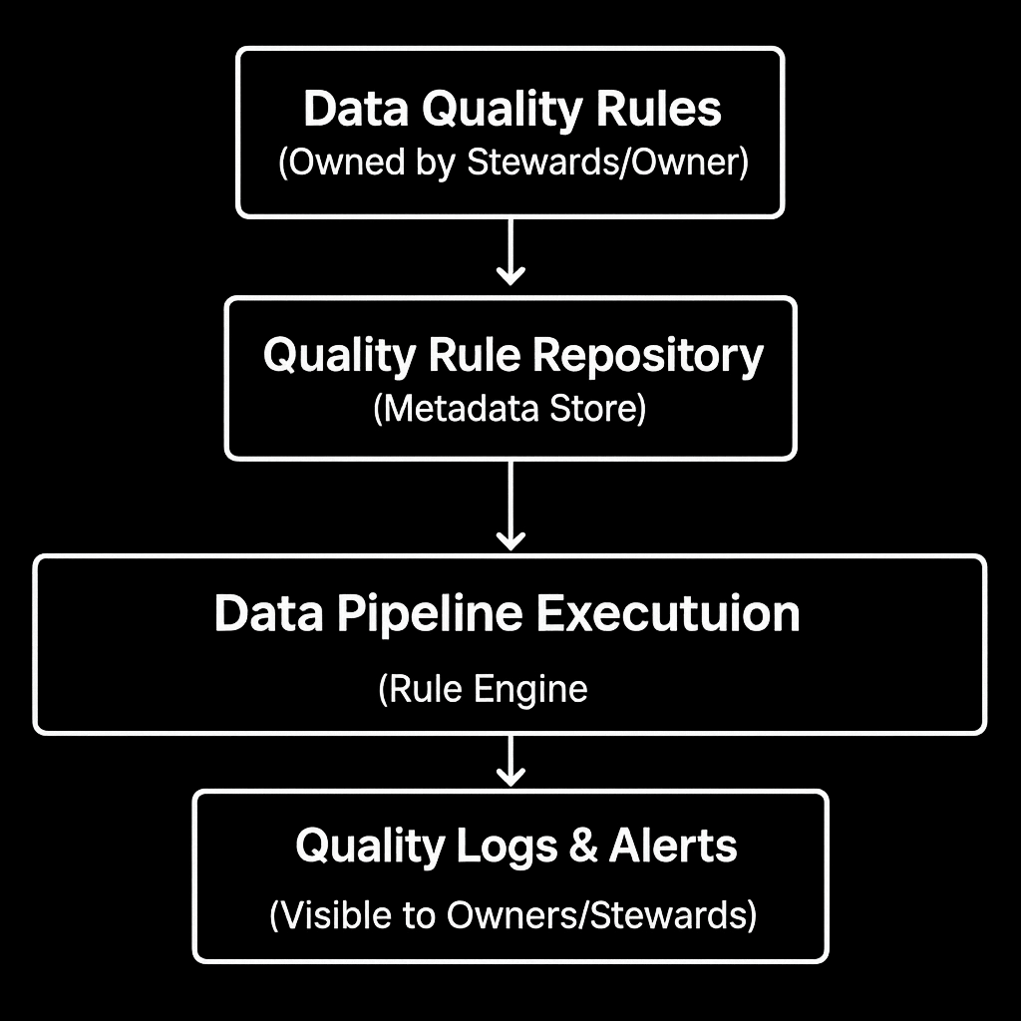
5. II. Data Quality Architecture
Notes:
Image source: Microsoft 365 content library Data governance is not just a committee, dashboard, or documentation exercise; it is about establishing clear ownership, definitions, and quality rules for organizational data. Effective governance includes transparency in data lineage, robust access control, and accountability for data management, ensuring consistent and trusted data usage across the business.

Slide 13
5. II. Sample Quality Schema (YAML)
rule_id: RULE_HKID_FORMAT
name: HKID Format Validation
domain: Supplier
field: hkid
rule_type: regex
pattern: "^[A-Z]{1,2}[0-9]{6}\\([0-9A]\\)$"
severity: error
description: "HKID must follow the official Hong Kong ID format."
owner: "owner.supplier@company.com"
steward: "steward.supplier@company.com"
applies_to:
- table: supplier_raw
column: hkid
on_failure:
action: quarantine
notify:
- steward.supplier@company.com
- owner.supplier@company.com
Notes:
Image source: Microsoft 365 content library Data governance is not just a committee, dashboard, or documentation exercise; it is about establishing clear ownership, definitions, and quality rules for organizational data. Effective governance includes transparency in data lineage, robust access control, and accountability for data management, ensuring consistent and trusted data usage across the business.

Slide 14
5. II. Sample Quality Schema (JSON)
{
"rule_id": "RULE_HKID_FORMAT",
"name": "HKID Format Validation",
"domain": "Supplier",
"field": "hkid",
"rule_type": "regex",
"pattern": "^[A-Z]{1,2}[0-9]{6}\\([0-9A]\\)$",
"severity": "error",
"description": "HKID must follow the official Hong Kong ID format.",
"owner": "owner.supplier@company.com",
"steward": "steward.supplier@company.com",
"applies_to": [
{
"table": "supplier_raw",
"column": "hkid"
}
],
"on_failure": {
"action": "quarantine",
"notify": [
"steward.supplier@company.com",
"owner.supplier@company.com"
]
}
}
Notes:
Image source: Microsoft 365 content library Data governance is not just a committee, dashboard, or documentation exercise; it is about establishing clear ownership, definitions, and quality rules for organizational data. Effective governance includes transparency in data lineage, robust access control, and accountability for data management, ensuring consistent and trusted data usage across the business.

Slide 15
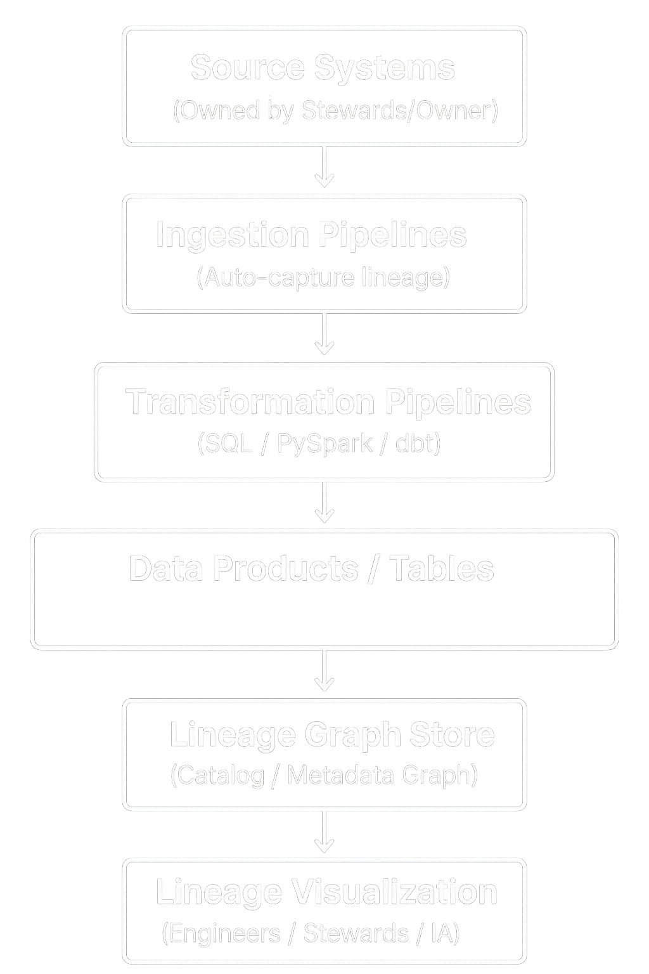
5. III. Data Lineage Extraction Architecture
Notes:
Image source: Microsoft 365 content library Data governance is not just a committee, dashboard, or documentation exercise; it is about establishing clear ownership, definitions, and quality rules for organizational data. Effective governance includes transparency in data lineage, robust access control, and accountability for data management, ensuring consistent and trusted data usage across the business.

Slide 16
5. III. SQL Lineage Extractor (Python Example)
import sqlparse
def extract_tables_from_sql(sql):
parsed = sqlparse.parse(sql)[0]
tokens = parsed.tokens
source_tables = set()
target_table = None
for token in tokens:
if token.ttype is None and token.value.upper().startswith("FROM"):
source_tables.add(token.value.split()[1])
if token.ttype is None and token.value.upper().startswith("JOIN"):
source_tables.add(token.value.split()[1])
if token.ttype is None and token.value.upper().startswith("INTO"):
target_table = token.value.split()[1]
return {
"source_tables": list(source_tables),
"target_table": target_table
}
Notes:
Image source: Microsoft 365 content library Data governance is not just a committee, dashboard, or documentation exercise; it is about establishing clear ownership, definitions, and quality rules for organizational data. Effective governance includes transparency in data lineage, robust access control, and accountability for data management, ensuring consistent and trusted data usage across the business.

Slide 17
5. III. Column‑Level Lineage Extraction (SQL)
def extract_column_lineage(sql):
parsed = sqlparse.parse(sql)[0]
select_section = None
for token in parsed.tokens:
if token.ttype is None and token.value.upper().startswith("SELECT"):
select_section = token.value
column_mappings = {}
select_items = select_section.replace("SELECT", "").split(",")
for item in select_items:
item = item.strip()
if " AS " in item.upper():
source, target = item.split(" AS ")
column_mappings[target.strip()] = source.strip()
else:
col = item.split(".")[-1]
column_mappings[col] = item.strip()
return column_mappings
Notes:
Image source: Microsoft 365 content library Data governance is not just a committee, dashboard, or documentation exercise; it is about establishing clear ownership, definitions, and quality rules for organizational data. Effective governance includes transparency in data lineage, robust access control, and accountability for data management, ensuring consistent and trusted data usage across the business.

Slide 18
5. III. PySpark Lineage Extractor (Simplified)
def extract_pyspark_lineage(df):
plan = df._jdf.queryExecution().logical()
lineage = {
"source_tables": [],
"columns": {}
}
def walk(node):
if "Relation" in str(node):
lineage["source_tables"].append(str(node))
for child in node.children():
walk(child)
walk(plan)
return lineage
Notes:
Image source: Microsoft 365 content library Data governance is not just a committee, dashboard, or documentation exercise; it is about establishing clear ownership, definitions, and quality rules for organizational data. Effective governance includes transparency in data lineage, robust access control, and accountability for data management, ensuring consistent and trusted data usage across the business.

Slide 19
5. III. Unified Lineage Metadata Output
{
"lineage_id": "LIN_SUPPLIER_VALIDATED",
"source_tables": ["supplier_raw", "compliance_check"],
"target_table": "supplier_validated",
"column_lineage": {
"supplier_id": "supplier_raw.supplier_id",
"country": "supplier_raw.country",
"compliance_status": "compliance_check.status"
},
"transformations": [
"LEFT JOIN compliance_check ON supplier_raw.supplier_id = compliance_check.supplier_id",
"Standardize country codes"
],
"pipeline": {
"name": "supplier_validation_pipeline",
"version": "1.0.3",
"last_run": "2026-01-02T14:00:00Z"
}
}
Notes:
Image source: Microsoft 365 content library Data governance is not just a committee, dashboard, or documentation exercise; it is about establishing clear ownership, definitions, and quality rules for organizational data. Effective governance includes transparency in data lineage, robust access control, and accountability for data management, ensuring consistent and trusted data usage across the business.

Slide 20
5. III. Engineering Notes
• Lineage must be automatic, not manual
• SQL lineage must support:
◦ SELECT
◦ JOIN
◦ CTEs
◦ Subqueries
◦ Aliases
• PySpark lineage must use the logical plan
• Lineage must be stored in a graph structure
• Lineage must be queryable for:
◦ Debugging
◦ Impact analysis
◦ Compliance
◦ Steward review
Notes:
Image source: Microsoft 365 content library Data governance is not just a committee, dashboard, or documentation exercise; it is about establishing clear ownership, definitions, and quality rules for organizational data. Effective governance includes transparency in data lineage, robust access control, and accountability for data management, ensuring consistent and trusted data usage across the business.

Slide 21
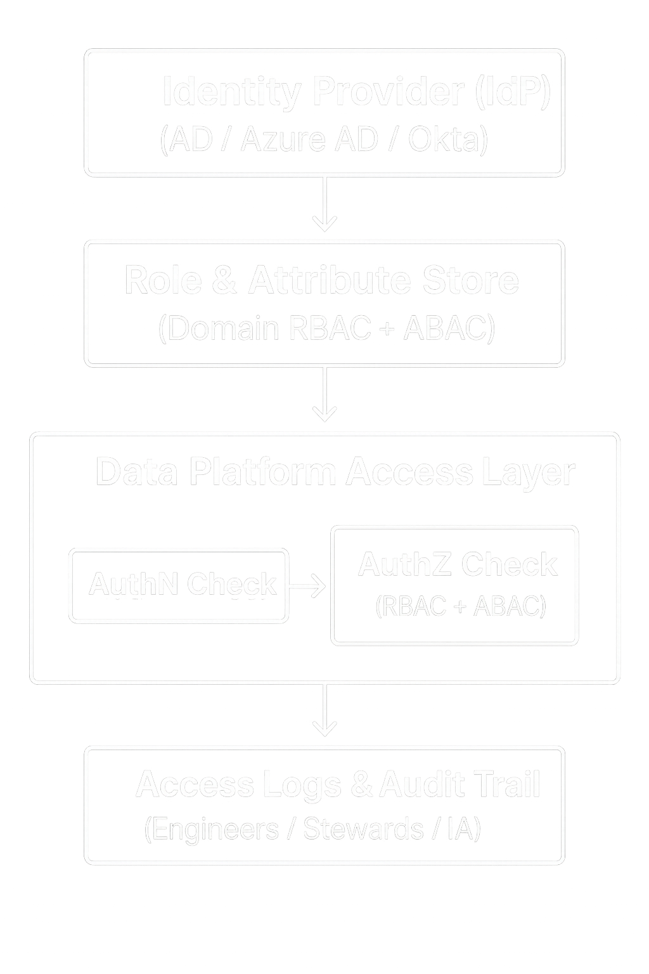
5. IV. Authentication & Authorization Architecture
Notes:
Image source: Microsoft 365 content library Data governance is not just a committee, dashboard, or documentation exercise; it is about establishing clear ownership, definitions, and quality rules for organizational data. Effective governance includes transparency in data lineage, robust access control, and accountability for data management, ensuring consistent and trusted data usage across the business.

Slide 22
5. IV. Domain-based RBAC (YAML)
roles:
SupplierTeam:
description: "Users who manage supplier onboarding and digital twins."
domains:
- Supplier
permissions:
- read
- write
ComplianceTeam:
description: "Users responsible for compliance checks and regulatory validation."
domains:
- Compliance
permissions:
- read
- write
- approve
PMOTeam:
description: "Users managing project assignments and certification validation."
domains:
- Project
permissions:
- read
DataSteward:
description: "Stewards who maintain glossary, rules, and metadata."
domains:
- Supplier
- Compliance
- Project
permissions:
- read
- write
- metadata_admin
DataOwner:
description: "Owners who approve access and usage."
domains:
- Supplier
- Compliance
- Project
permissions:
- approve
- read
Notes:
Image source: Microsoft 365 content library Data governance is not just a committee, dashboard, or documentation exercise; it is about establishing clear ownership, definitions, and quality rules for organizational data. Effective governance includes transparency in data lineage, robust access control, and accountability for data management, ensuring consistent and trusted data usage across the business.

Slide 23
5. IV. ABAC Attribute Definitions (YAML)
These attributes are attached to users and data records.
user_attributes:
region: ["HK", "CN", "SG", "EU"]
clearance_level: ["low", "medium", "high"]
certification: ["none", "basic", "advanced"]
job_function: ["supplier_ops", "compliance", "pmo", "audit"]
data_attributes:
region: ["HK", "CN", "SG", "EU"]
sensitivity: ["low", "medium", "high"]
domain: ["Supplier", "Compliance", "Project"]
Notes:
Image source: Microsoft 365 content library Data governance is not just a committee, dashboard, or documentation exercise; it is about establishing clear ownership, definitions, and quality rules for organizational data. Effective governance includes transparency in data lineage, robust access control, and accountability for data management, ensuring consistent and trusted data usage across the business.

Slide 24
5. IV. Combined RBAC + ABAC Access Policy Template
core governance logic
access_policies:
- name: Supplier_Domain_Read
applies_to: Supplier
allow_if:
rbac_role: SupplierTeam
deny_if:
data.sensitivity: high
user.clearance_level: low
- name: Compliance_Domain_Write
applies_to: Compliance
allow_if:
rbac_role: ComplianceTeam
deny_if:
user.certification: none
- name: Project_Domain_Read
applies_to: Project
allow_if:
rbac_role: PMOTeam
deny_if:
data.region != user.region
- name: Steward_Metadata_Admin
applies_to: "*"
allow_if:
rbac_role: DataSteward
Notes:
Image source: Microsoft 365 content library Data governance is not just a committee, dashboard, or documentation exercise; it is about establishing clear ownership, definitions, and quality rules for organizational data. Effective governance includes transparency in data lineage, robust access control, and accountability for data management, ensuring consistent and trusted data usage across the business.

Slide 25
5. IV. Row-Level Security (ABAC) Template
region-based filtering
row_level_security:
- name: Region_Filter
condition: "record.region == user.region"
applies_to:
- Supplier
- Project
Notes:
Image source: Microsoft 365 content library Data governance is not just a committee, dashboard, or documentation exercise; it is about establishing clear ownership, definitions, and quality rules for organizational data. Effective governance includes transparency in data lineage, robust access control, and accountability for data management, ensuring consistent and trusted data usage across the business.

Slide 26
5. IV. Field-Level Security Template
protects sensitive fields like HKID, passport, tax ID
field_level_security:
- field: hkid
mask_if:
user.clearance_level: low
mask_type: partial
mask_pattern: "A******(X)"
- field: tax_id
mask_if:
user.job_function != "compliance"
mask_type: nullify
Notes:
Image source: Microsoft 365 content library Data governance is not just a committee, dashboard, or documentation exercise; it is about establishing clear ownership, definitions, and quality rules for organizational data. Effective governance includes transparency in data lineage, robust access control, and accountability for data management, ensuring consistent and trusted data usage across the business.

Slide 27
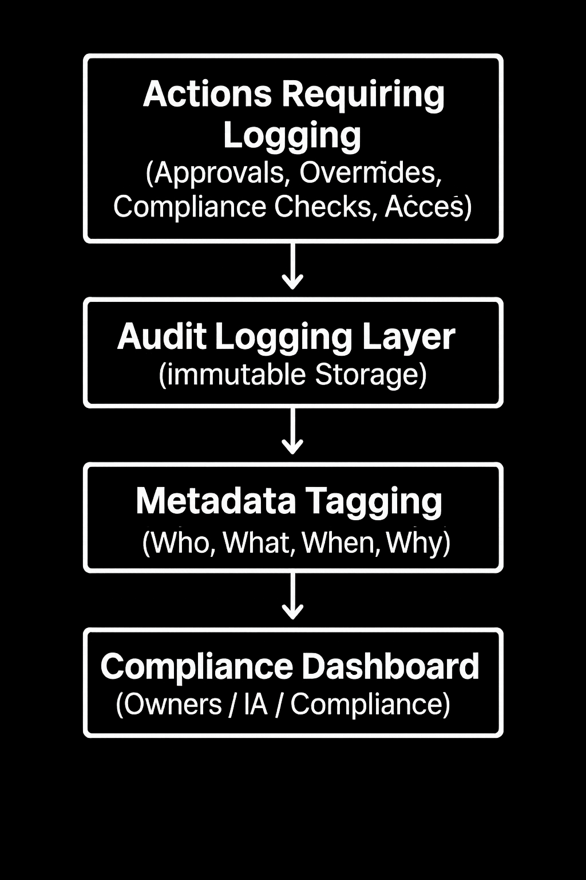
5. V. Accountability Trails Architecture
Notes:
Image source: Microsoft 365 content library Data governance is not just a committee, dashboard, or documentation exercise; it is about establishing clear ownership, definitions, and quality rules for organizational data. Effective governance includes transparency in data lineage, robust access control, and accountability for data management, ensuring consistent and trusted data usage across the business.

Slide 28
5. V. Access Approval Workflow Template
This ties RBAC/ABAC to Data Owner approvals
access_workflow:
- name: Supplier_Domain_Access_Request
domain: Supplier
approval_required: true
approver: DataOwner
notify:
- DataSteward
- ComplianceTeam
- name: Compliance_Domain_Access_Request
domain: Compliance
approval_required: true
approver: DataOwner
notify:
- InternalAudit
Notes:
Image source: Microsoft 365 content library Data governance is not just a committee, dashboard, or documentation exercise; it is about establishing clear ownership, definitions, and quality rules for organizational data. Effective governance includes transparency in data lineage, robust access control, and accountability for data management, ensuring consistent and trusted data usage across the business.

Slide 29
5. V. Audit Logging Template
Every access decision must be logged.
audit_log:
fields:
- user_id
- user_role
- user_attributes
- resource
- domain
- action
- decision
- reason
- timestamp
- approver
- policy_applied
Notes:
Image source: Microsoft 365 content library Data governance is not just a committee, dashboard, or documentation exercise; it is about establishing clear ownership, definitions, and quality rules for organizational data. Effective governance includes transparency in data lineage, robust access control, and accountability for data management, ensuring consistent and trusted data usage across the business.

Slide 30
5. V. Example Access Decision Output (Governance-Ready)
{
"user": "amy.chan",
"role": "SupplierTeam",
"attributes": {
"region": "HK",
"clearance_level": "medium"
},
"resource": "supplier_validated",
"domain": "Supplier",
"action": "read",
"decision": "allow",
"policy_applied": "Supplier_Domain_Read",
"timestamp": "2026-01-02T14:45:00Z"
}
Notes:
Image source: Microsoft 365 content library Data governance is not just a committee, dashboard, or documentation exercise; it is about establishing clear ownership, definitions, and quality rules for organizational data. Effective governance includes transparency in data lineage, robust access control, and accountability for data management, ensuring consistent and trusted data usage across the business.

Slide 31
Appendix

Slide 32
Roles and Functions – Data Owner
Owns the truth of the domain.
Approves usage
Signs off on compliance
Prioritizes access requests
Monitors usage patterns
Ensures data is used appropriately

Slide 33
Roles and Functions – Data Steward
Operates under the Data Owner.
Owns the data glossary
Defines quality rules
Ensures lineage clarity
Maintains the data dictionary (technical schema)

Slide 34
Roles and Functions – Data Custodian
Knows the source systems best.
Understands source schema
Knows which fields are reliable
Advises what to extract and how

Slide 35
Roles and Functions – Data Engineer
The Implementer
Builds schema & repositories
Implements glossary in metadata
Implements lineage
Implements authentication & authorization
Ensures pipelines comply with standards

Slide 36
Roles and Functions – Consulting Functions
Cybersecurity, Compliance, Internal Audit, etc
Provide privacy rules
Provide security standards
Provide regulatory requirements

